Slide 1
APL Arduino Course Spring 2014 Edition Introduction
May 12, 2014
Tara Echlin & Team
Notes:
Please hold questions til the end of the intro.

Slide 2
Public Service Announcements
There is a stand-by list. If you’re not registered for the course and want to stay after the introduction, see the woman in the gold derby hat.
Please hold questions until the end.

Slide 3

Take Chances
Make Mistakes
Get Messy
Innovate
Introduction

Slide 4
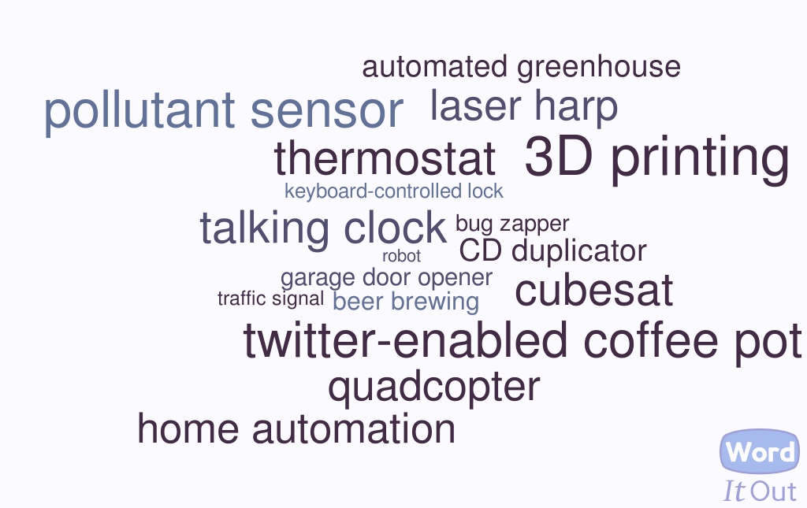
Some Arduino Applications

Slide 5
Why Arduino?
Why me?
Low Cost + Community
Failure OK!
++Creativity
Turn tough hardware problems into easy software problems
Rapid Prototyping
Notes:
low-cost, ubiquitous open source microcontroller
Cheap replacement cost + Huge supporting community
reduced price of failure
++creativity
Information Hiding: turn tough hardware problems into easy software problems
=> Rapid Prototyping
“Every so often a piece of technology can be- come a lever that moves the world, just a little bit. The Arduino is one of those levers.
It started off as a project to give artists ac- cess to embedded microprocessors for inter- action design projects, but I think it’s going to end up in a museum, someday, as a building block of the future world. Arduino allows rapid, cheap, prototyping for embedded systems. It turns what used to be fairly tough hardware problems into much simpler software prob- lems. And it’s become the poster child of the Maker Movement.
Based around the 8-bit Atmel AVR micro- controller line, the Arduino board breaks out digital, analog, and other pins from the con- troller in an idiosyncratic footprint that’s be- come a de facto industry standard. It’s a solid development platform, both for experienced hardware hackers and absolute beginners.
The real power of Arduino isn’t really in the hardware, but the software — the Arduino IDE. While there are many other boards offering similar functionality, the Arduino has best suc- ceeded at packing the complex, messy details of microcontroller programming in a user- friendly package. It has spawned many imita- tors and derivatives, and a huge community.
For now, at least, Arduino sits apart from the rest of the microcontroller market, and 20 or 30 years in the future we may look back on it like the Commodore 64, the Apple II, or (for the true old-timers) the PDP-11. These days Arduino is almost always a newbie’s “first board,” and it's influencing an entire genera- tion of makers.”
- Alasdair Allan, Make:36, p.51

Slide 6

People Over Megahertz
“It’s more important to take care of the experience people have when they learn, than to give them power they don’t know what to do with.”
- Massimo Banzi
Introduction
Notes:
“… Arduino boards are a mashup of open technologies wrapped up in a unified user experience. From the out-of-the-box experience we want to know how long it takes you to go from zero to something that works. This is very important because it creates positive reinforcement that you are on the right path. The longer that time is, the more people you lose in the process. … You can put in a processor that is 100MHz more than another one, but the way you interact with it makes a huge difference to people. It’s more important to take care of the experience people have when they learn than to give them power they don’t know what to do with.”
- Massimo Banzi, co-founder of the Arduino project, Make:36, p.14

Slide 7
What is an Arduino?
Who am I, really?
The Arduino Project
Open source
Processors
Many I/O options
Hardware specific to board
Add “shields”
Arduino programming language
Integrated Development Environment
Notes:
A microcontroller board designed by Massimo Banzi & team at The Arduino Project (arduino.cc)
Processors: mostly 8-bit Atmel AVR microcontroller line
Selection of I/O & power pins, USB connection
Hardware specific to the Arduino board
Add “shields” or “breakout boards” to gain functionality
Arduino programming language
A subset of C
Arduino Integrated Development Environment (IDE)
The Arduino founders are: Massimo Banzi, David Cuartielles, Tom Igoe, Gianluca Martino, and David Mellis. The Arduino Project’s website is arduino.cc.
Processors chosen from the 8-bit Atmel AVR microcontroller line, until recently: the new Arduino Due uses a 32 bit ARM.
Arduinos & compatible systems: Processors chosen from a handfull of microcontrollers, ranging from 8 to 32 bits. (Ref: https://en.wikipedia.org/wiki/List_of_Arduino_boards_and_compatible_systems).

Slide 8
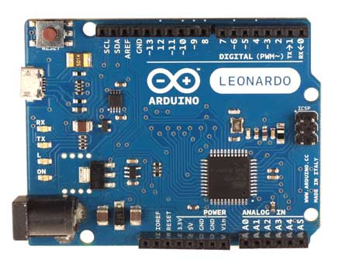
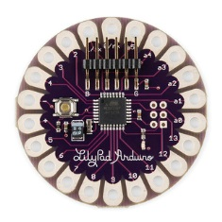
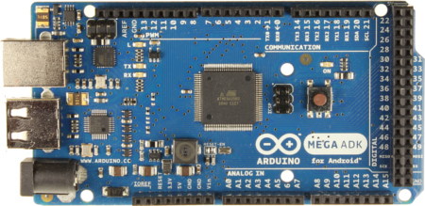
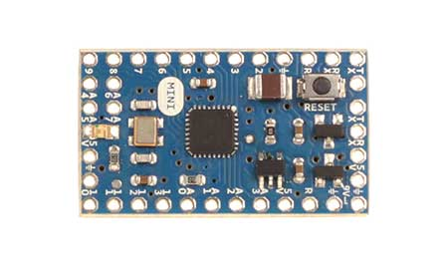
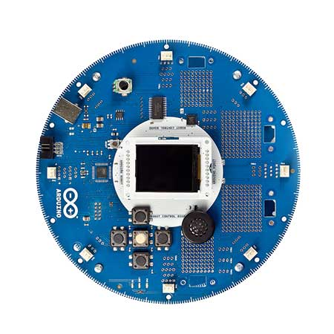
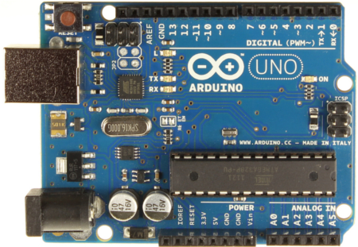
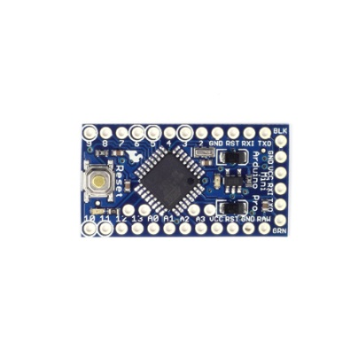
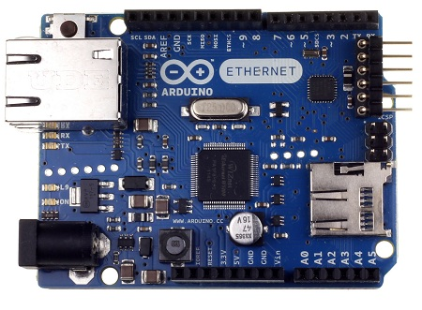
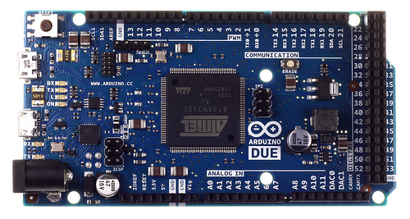
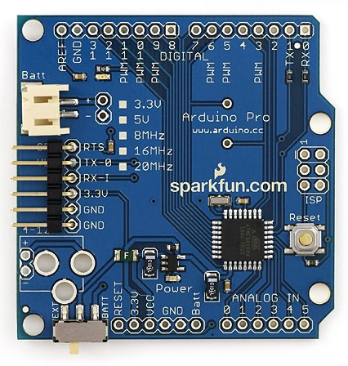
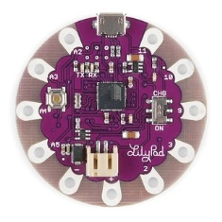
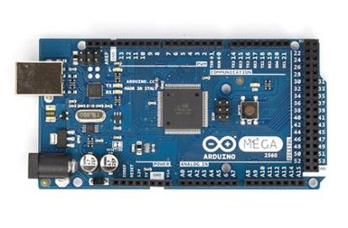
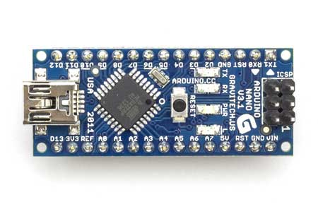
Which Arduino?
I come from a large family.

Slide 9
Which Arduino?
Decisions, decisions …
Currently 19 “official” boards
24 (?) “official” boards over 10 years
Many clones/variants
Support & quality?
Reasons to use the Arduino Uno Rev 3 (R3) for this course:
“official reference model”
Most recent tutorials/projects are based on the Uno R3
R3 is the current revision
Leonardo not backwards-compatible with Uno
Introduction
Notes:
Currently 19 “official” boards
24 (?) “official” boards over 10 years
Many clones/variants
Some vendors have cheaper/faster/more powerful alternatives
Support & quality?
Reasons to use the Arduino Uno Rev 3 (R3) for this course:
The Uno is the “official reference model” for the Arduino platform¹
Most recent tutorials/projects are based on the Uno
R3 is the current revision
Using a Leonardo instead might be confusing because the USB port has dual use (serial & USB comms); see John Boxall reference below
1. http://arduino.cc/en/Main/arduinoBoardUno
“If you are shopping for your first Arduino board, please don’t use an Arduino Leonardo – the pinouts vary and for some chapters of this tutorial the board will not work and is not supported here. There isn’t anything wrong with the Leonardo, it just isn’t fully backwards compatible with Uno boards” - John Boxall, author of Arduino Workshop from No Starch Press
Current boards:
http://arduino.cc/en/Main/Products
All boards including “legacy” products:
http://arduino.cc/en/Main/Boards

Slide 10
Welcome to Your Arduino Uno R3
Microcontroller | ATmega328
Operating Voltage | 5V
Input Voltage (recommended) | 7-12V
Input Voltage (limits) | 6-20V
Digital I/O Pins | 14 (of which 6 provide PWM output)
Analog Input Pins | 6
DC Current per I/O Pin | 40 mA
DC Current for 3.3V Pin | 50 mA
Flash Memory | 32 KB of which 0.5 KB used by bootloader
SRAM | 2 KB
EEPROM | 1 KB
Clock Speed | 16 MHz

Slide 11

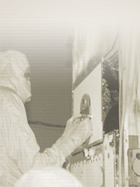
Welcome to Your Arduino Uno Rev 3
digital and PWM (“analog”) input/output pins
reset button
Onboard LEDs
USB
connection
ATMega328
processor
power jack
control pins
power pins
analog in pins
Introduction

Slide 12
Breakdown
When to Use an Arduino Uno
Need to keep track of many low-data-rate sensors
Need to control many low-power display elements
Need to attach to analog sensors and discrete digital inputs
Need timely input or output
Limited available power
Need small volume
When Not to Use an Arduino Uno
Intense number-crunching
Data + program size > 32 Kbytes
Need moderate input, e.g., keyboard, mouse
Need complex input/output; e.g., LAN, Wifi
Need full-featured HDMI display or sound
Need "threads"

Slide 13
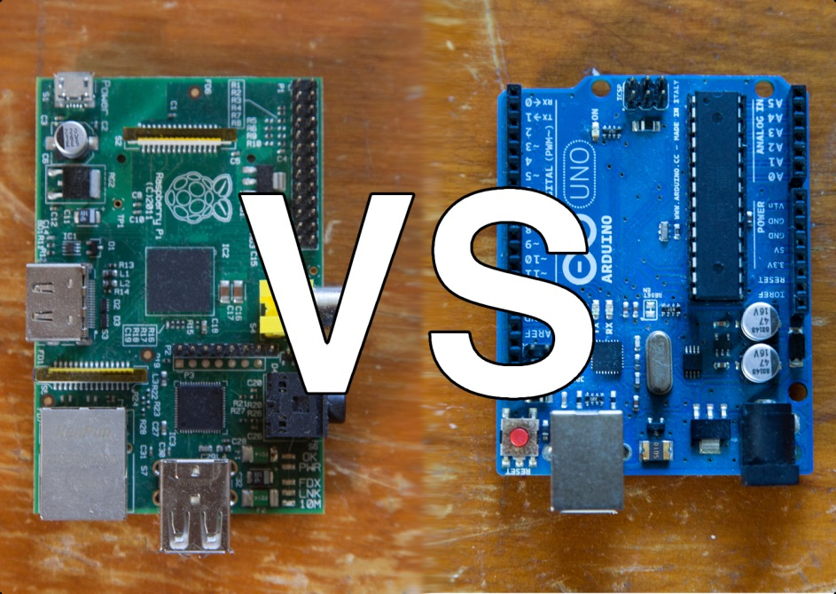
Arduino vs. Raspberry Pi
Apples to oranges?
A “typical” Arduino has more I/O options but the Pi has more computing power
The difference is largely made moot by the diversity of Arduino boards available
See Make Magazine, Issue 36 for a broader comparison of microcontroller boards available (but the Pi is usually considered an “SBC”)
Introduction

Slide 14

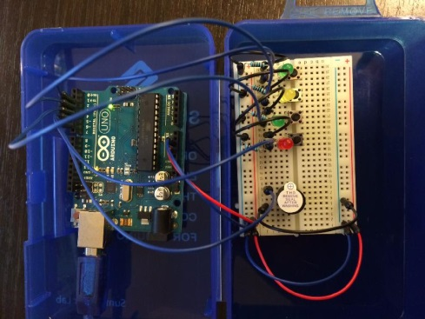
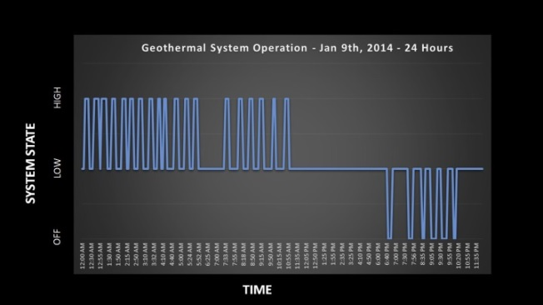
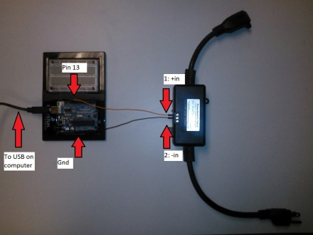
The Rest of the Arduino Course
Arduino 101
Basics of programming in the Arduino IDE
Build basic circuits
Use sensors & actuators
Dinner
Project
What will you make?
References
void setup() {
doSetup();
}
void loop() {
doStuff();
}

Slide 15
Next Step: Arduino 101
Maker Central:
Tara Echlin
Switched Line Cord
Jim Bogard
Monkey {Anything} Guardian
Robert Berardino
Chris Monaco
Design Central:
Mars Gralia
Data Logger
Bruce Ballard
Twisted Simon Says
Zaza Soriano
Brian Taylor

Slide 16
On your way to Maker Central/Design Central, pick up a set of hardware goodies (Arduino 101 materials) at the coffee cart.
South End: Monkey
Men’s
Room
North End: Line Cord
Maker Central
Center Section: Logger
Women’s
Room
Coffee cart
Design Central
Kitchen
Entrance to Cafeteria
Stairs
Central
Park
West End: Simon
Front
Door
Academy
Central
Table with hand-outs for “Arduino 101” phase
We are here

Slide 17
Questions?

Slide 18


Recommended Online References
Arduino.cc
Reference section contains language reference
Products section describes hardware and links to datasheets
Learn.adafruit.com
https://learn.adafruit.com/category/learn-arduino
Simon Monk’s tutorials:
https://learn.adafruit.com/lesson-0-getting-started
Make:
http://makezine.com/category/electronics/arduino/
Warning to EE’s: Many online references lack schematics
Introduction

Slide 19

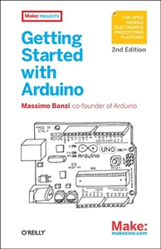
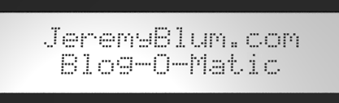
Other Recommended References
30 Arduino Projects for the Evil Genius, Second Edition – Simon Monk
Getting Started with Arduino, 2nd Edition – Massimo Banzi
Jeremy Blum: books, tutorials, blogs and videos
There are many others ...
Introduction
Notes:
30 Arduino Projects for the Evil Genius, Second Edition uses the Uno (easier).
http://www.jeremyblum.com/category/arduino-tutorials/

Slide 20
Electronics - Recommended References
To Start:
Getting Started in Electronics by Forrest Mims III
Make: Electronics Book
"Learn Electronics with Arduino“ by Don Wilcher *
Advanced:
The Art of Electronics*
Introduction
Notes:
To Start:
Getting Started in Electronics by Forrest Mims III
Make: Electronics Book
"Learn Electronics with Arduino“ by Don Wilcher *
Advanced:
The Art of Electronics*
*Recommending based on others’ experience.
Common way to learn electronics is to learn Arduino then extend the electronics outboard of the Arduino itself. E.g., add sensors and actuators via the "I2C bus". E.g., "Learn Electronics with Arduino“ by Don Wilcher

